Slide 1
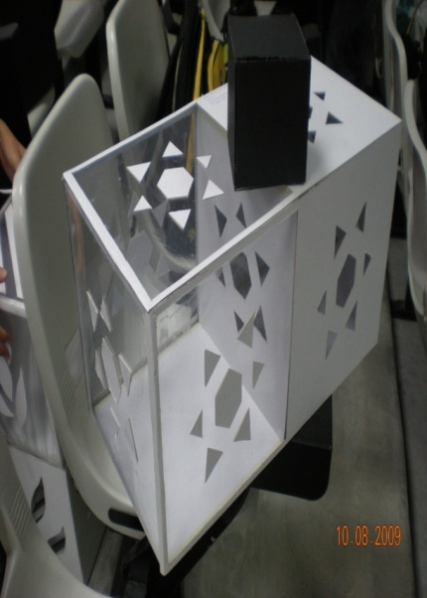
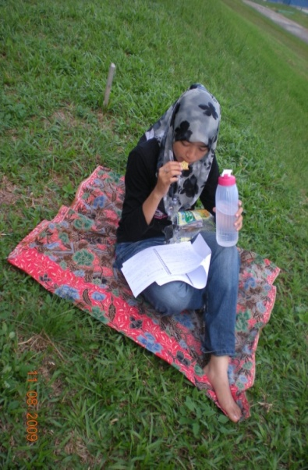
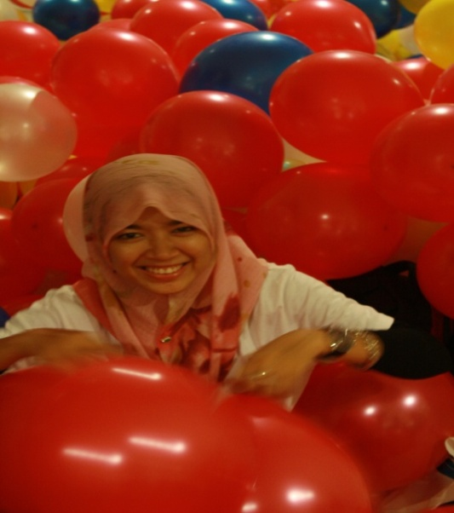
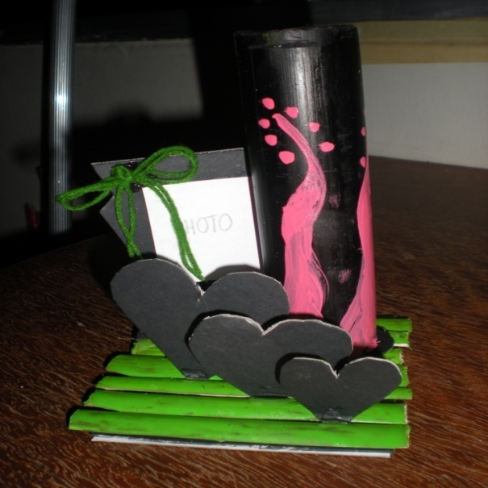
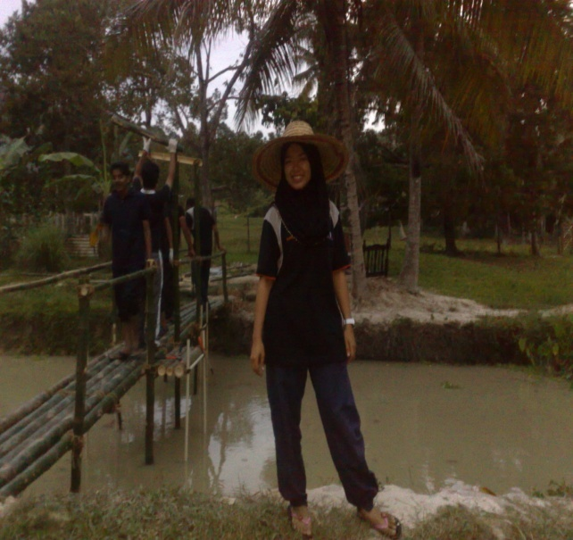
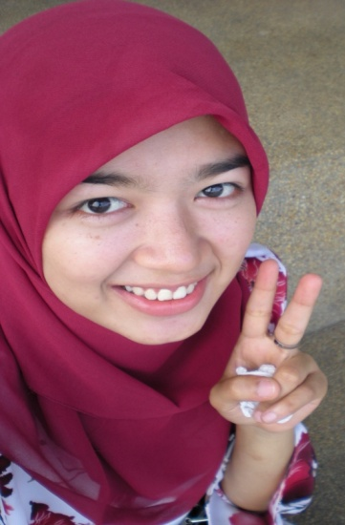
From RUS101, I learnt many things that I have never expected.
I expect HBP course only teaching us about construction…but I’m wrong…HBP course is cool…it brings me from nobody to be somebody…I proud to tell community that I’m a student of Housing, Building and Planning school…
ANIS AMIRA BT. ABDUL RAHIM 103652 (Building Technology)

Slide 2

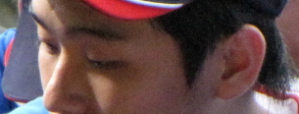

Joon Fei
Usefulness??? Yes, indeed I have gained many
invaluable experiences throughout the RUS 101
program. Mind-modification ability is the most useful
tool I armed myself with after this program… Mind power
is unpredictable and with proper positive thinking or
self-determination(not arrogance), impossible is really
nothing for us. :-p
And about the
Uselessness????
No, a definite answer
from me..

Slide 3
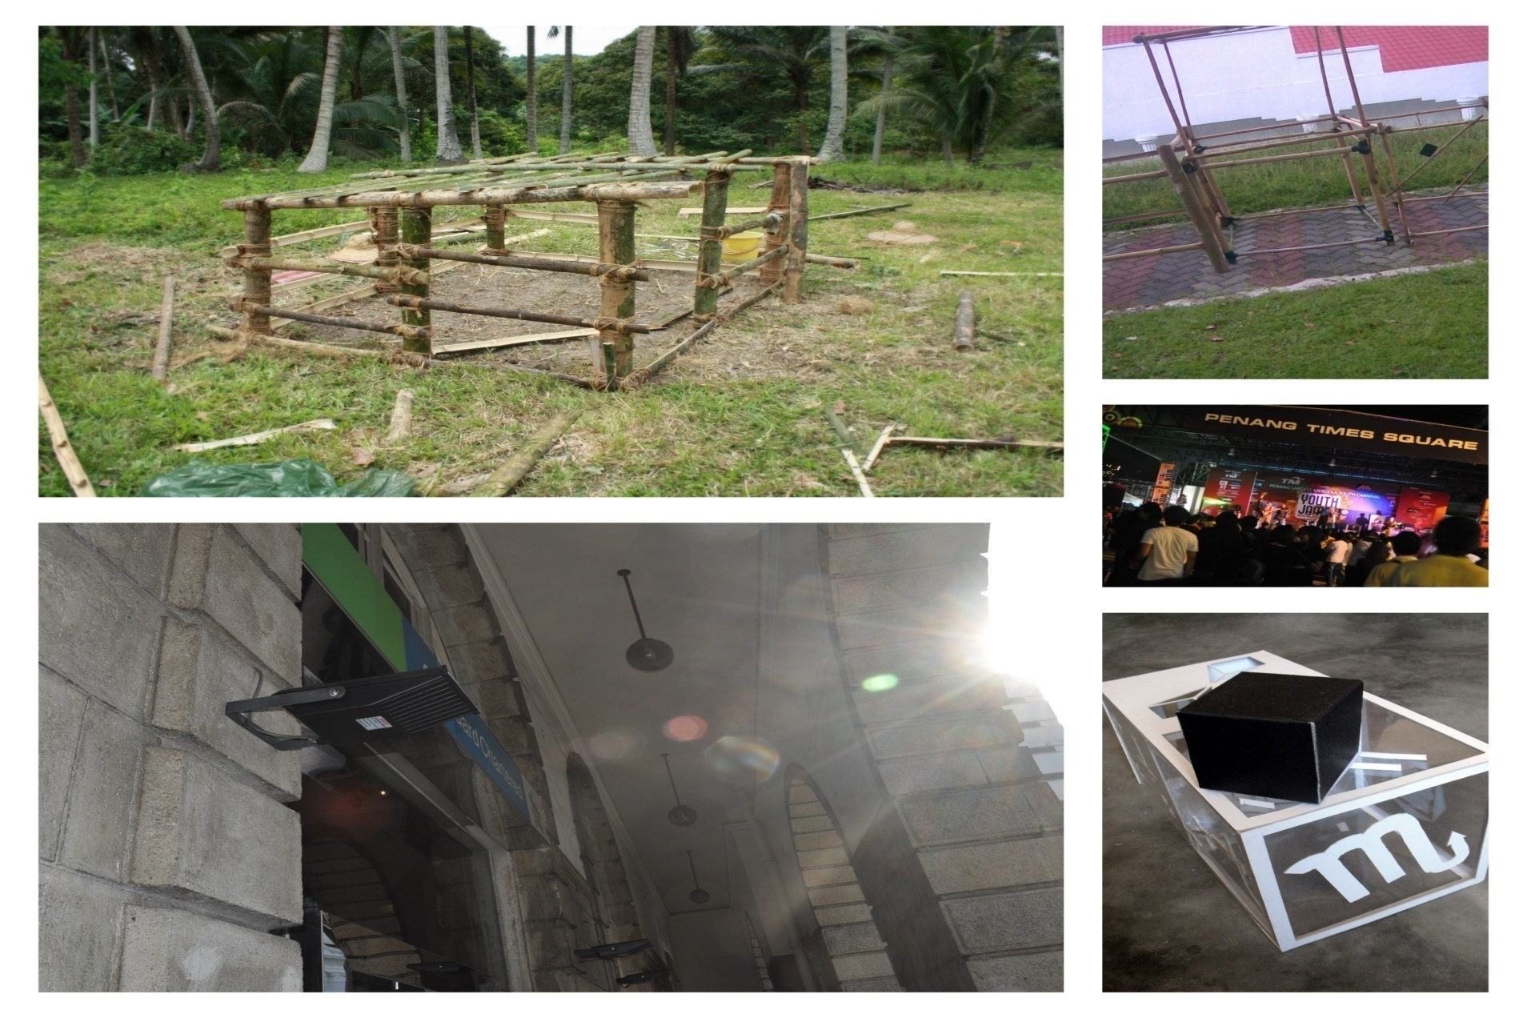
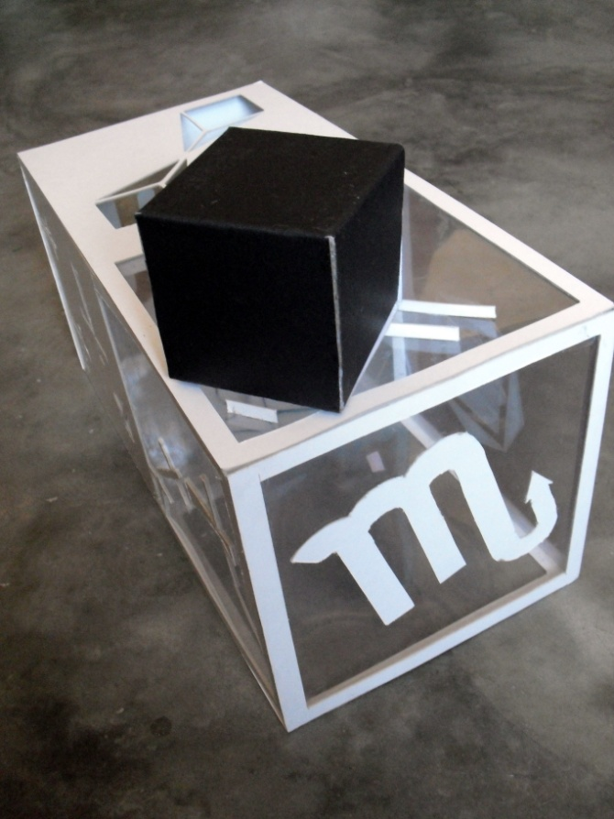
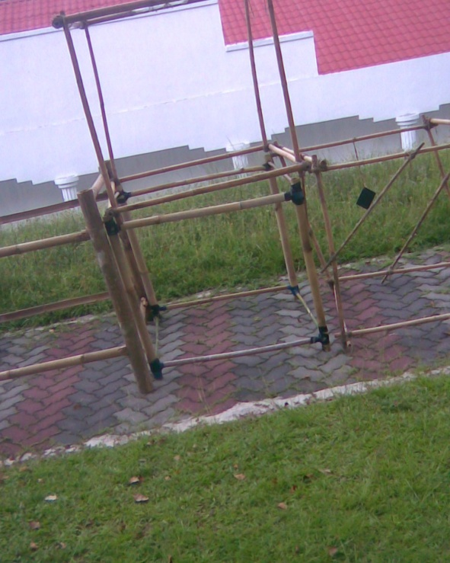
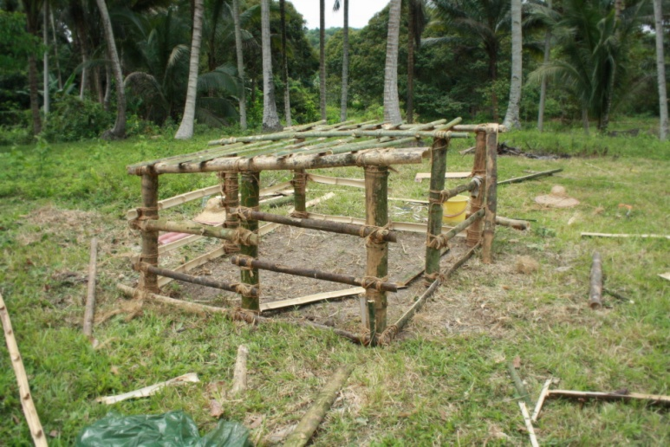
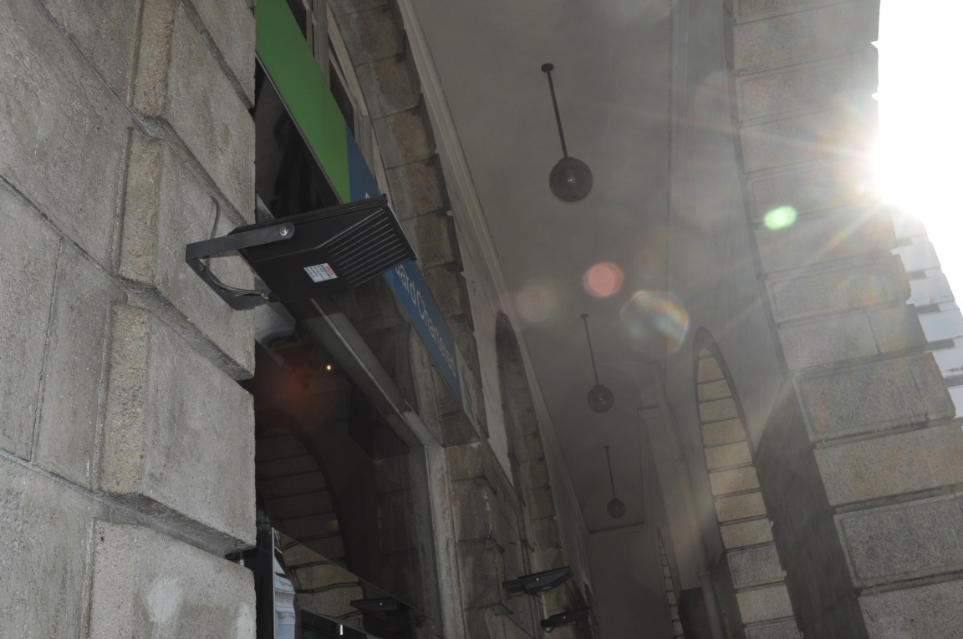
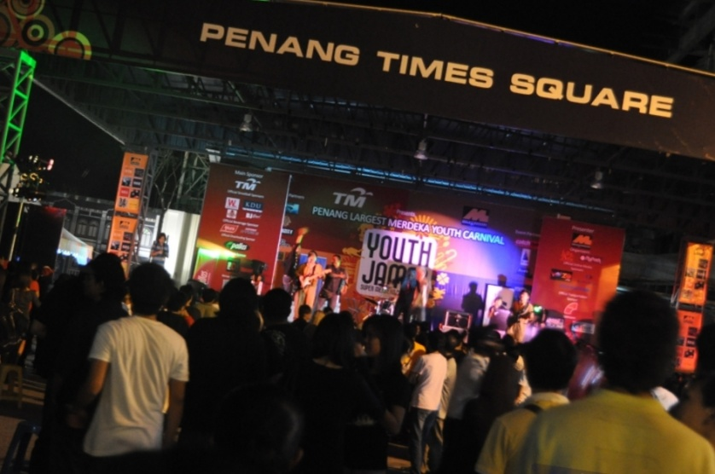
Joon Fei

Slide 4
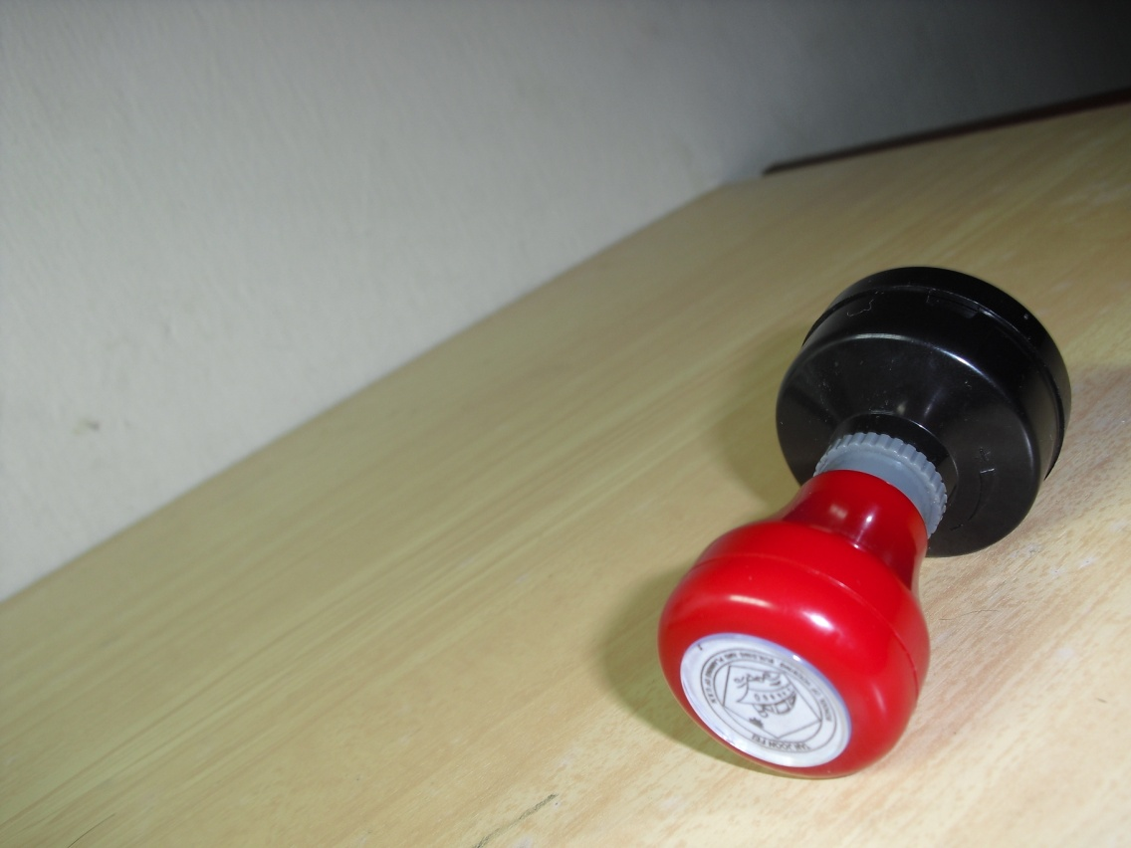
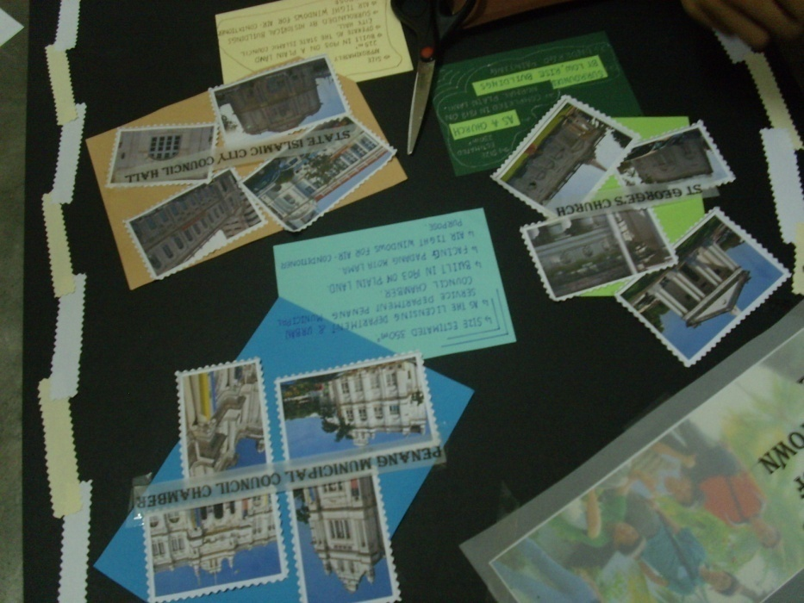
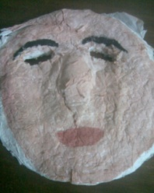
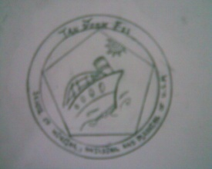
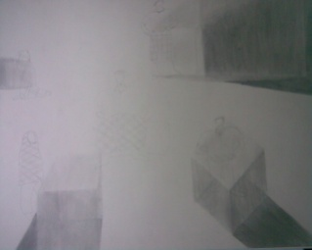
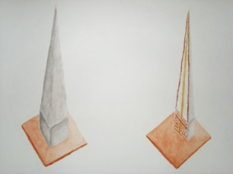
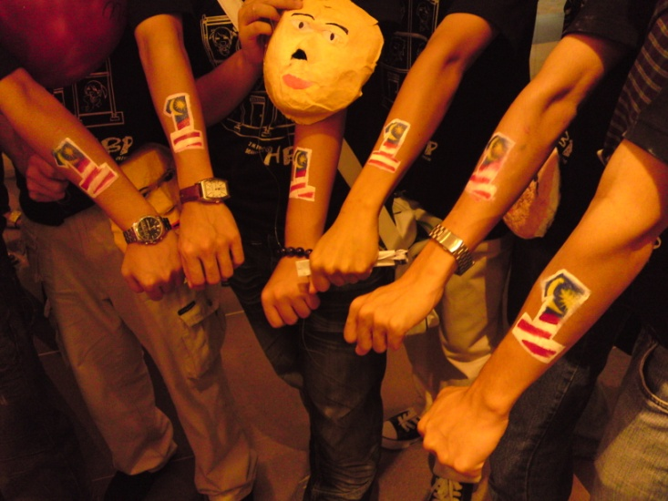
Joon Fei

Slide 5
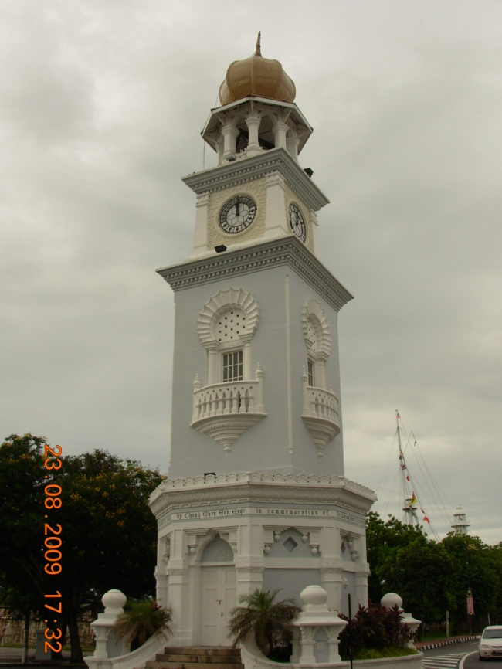
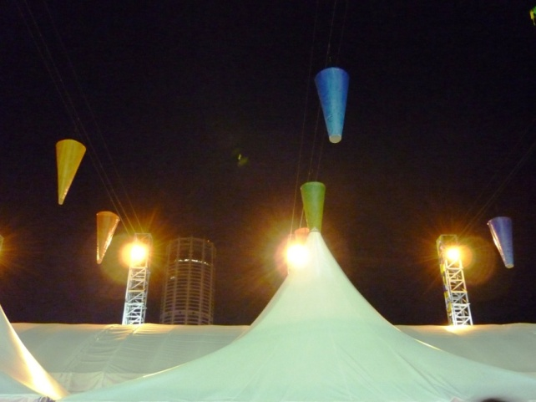
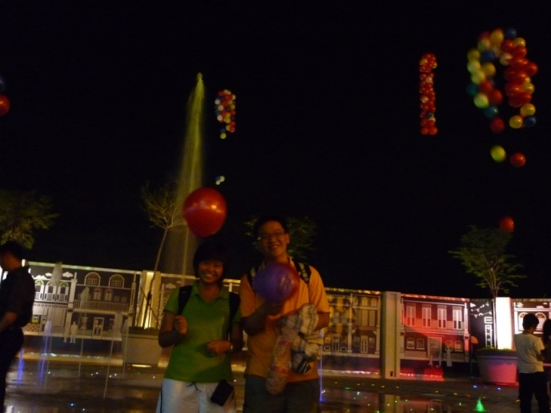
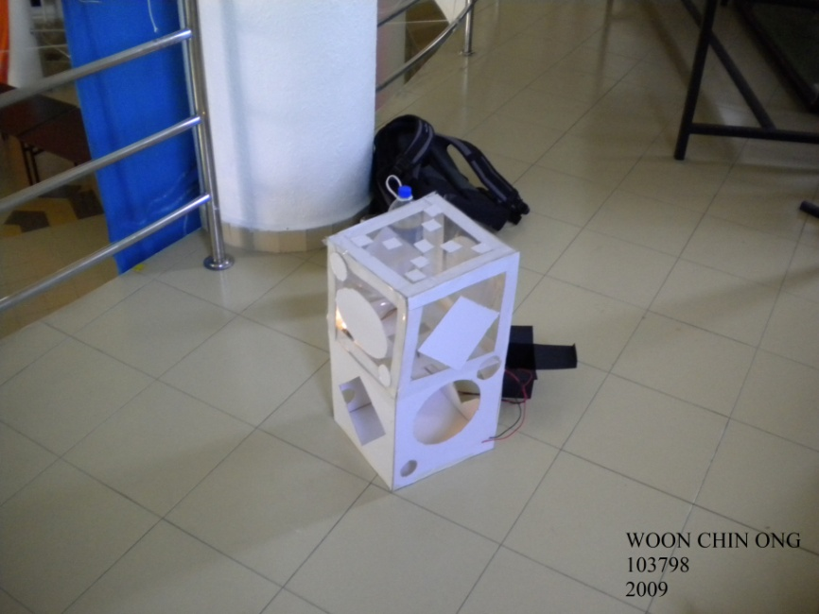
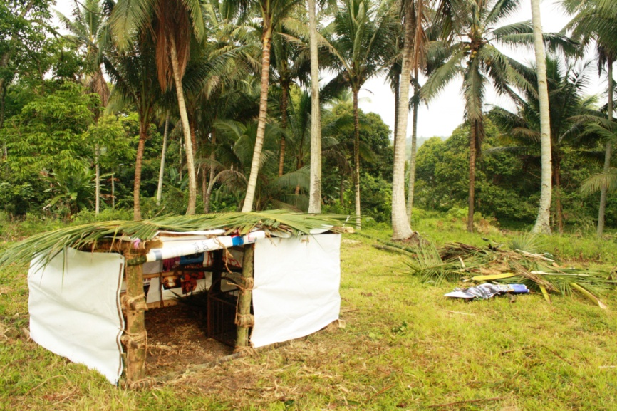
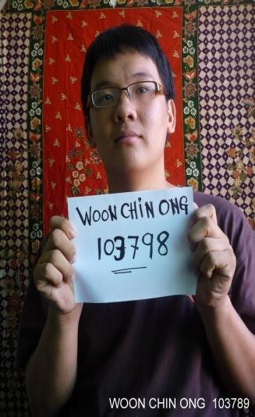
FROM THESE PROJECTS, I HAVE LEARNT HOW TO HANDLE THE PROBLEM , TENSION AND TIME MANAGEMENT.
THIS IS BECAUSE I ALWAYS TAKE PART IN THE SOCIETY ACTIVITIES.
AFTER LONG PERIOD FOR TRAINING, I CAN SUCCESSFULLY TO HANDLE THESE PROBLEM ALREADY.
WOON CHIN ONG 103798 BUILDING SERVEYING

Slide 6
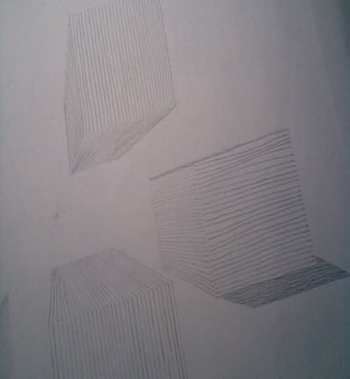
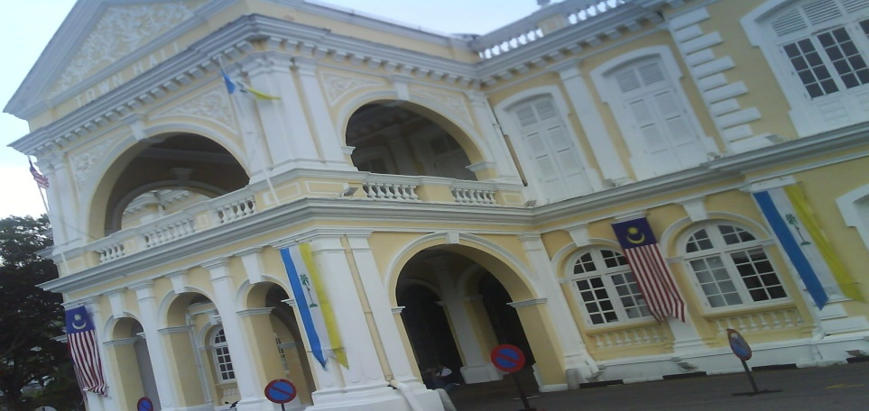
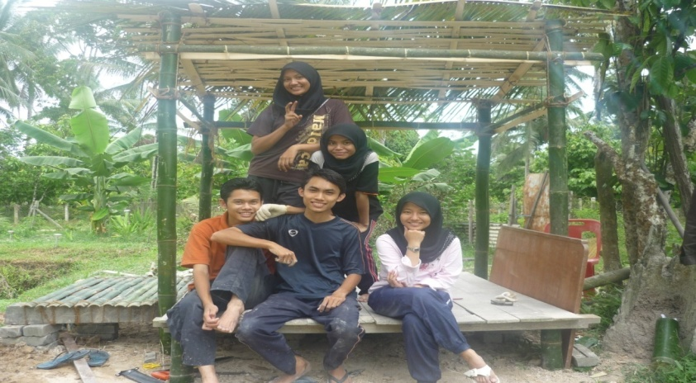
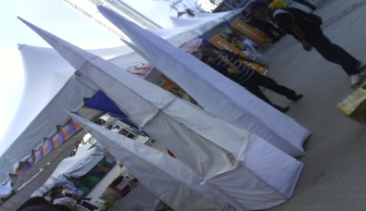
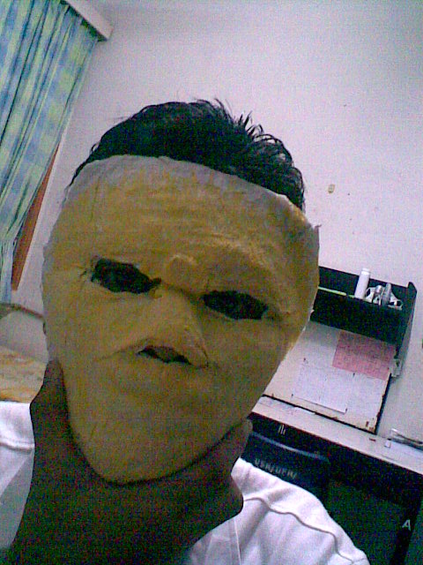
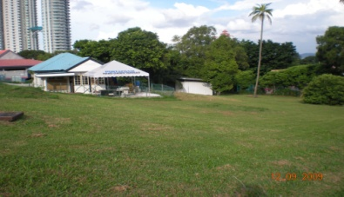

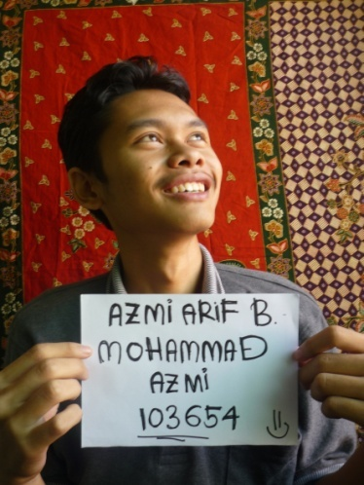
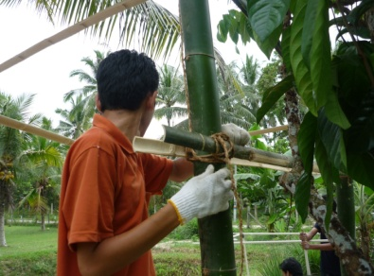
I learn about layers in this life, & how important to know it before we doing something.
I know the usefulness of different skill and try to apply it Into assignment and make it better.
My thinking way become more universal and know to best thing before making decision
I ready to apply all the skills that I have to make something
Know the important of refinement and use it to make my work better.
AZMI ARIF BIN MOHAMMAD AZMI 103654 ARCHITECTURE

Slide 7
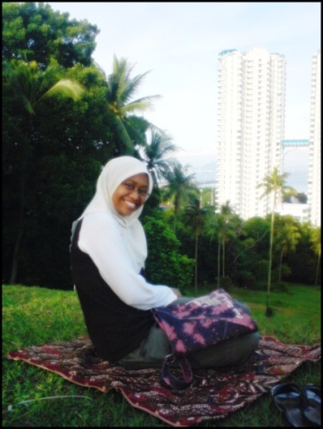
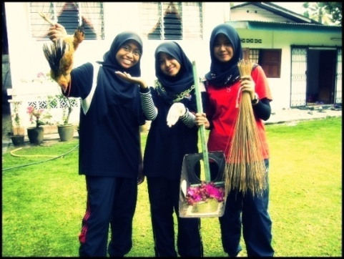
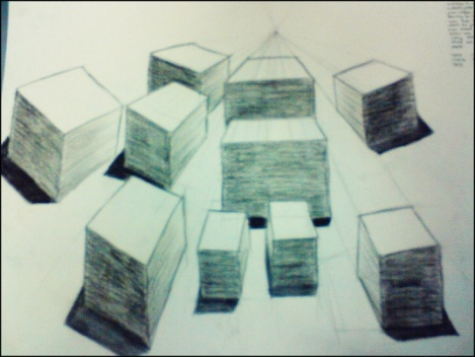
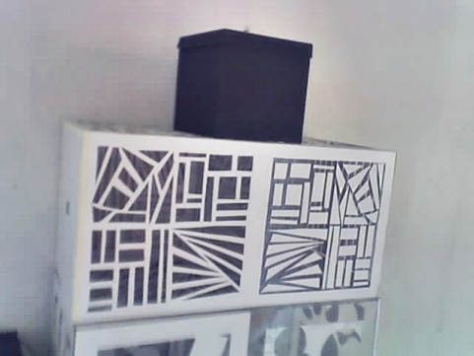
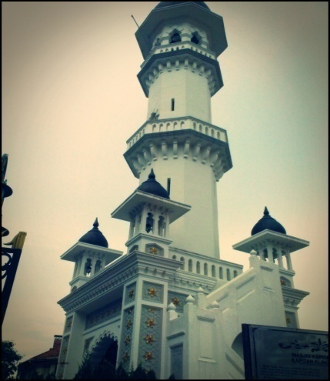
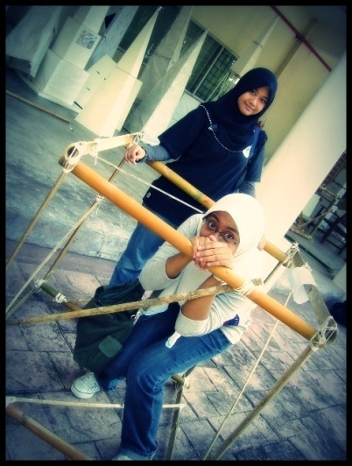
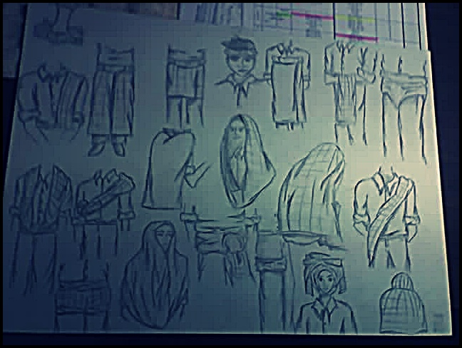
Along my journey here…
I was exposed by many task that sometimes I never expected to do so. I have experience how to sacrifice time, although it was the busiest time, accept or respect people opinion, discipline myself, how to cooperate with the group member like planning something together or try to not disagree each other and all those things while put it together, I feels like there are many things that I should improve from myself.
So, in this learning skill, I realize that mistake is not to pull us down, but it was the best teacher that can we refer to.
LILY NATRAH BINTI AMIR ZAKI (103689)

Slide 8
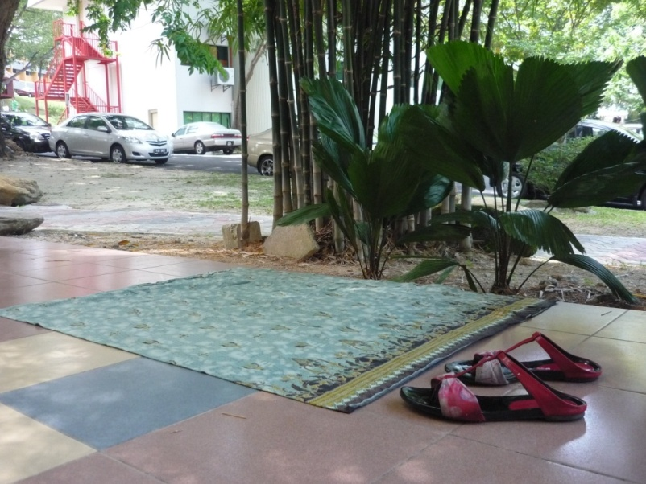
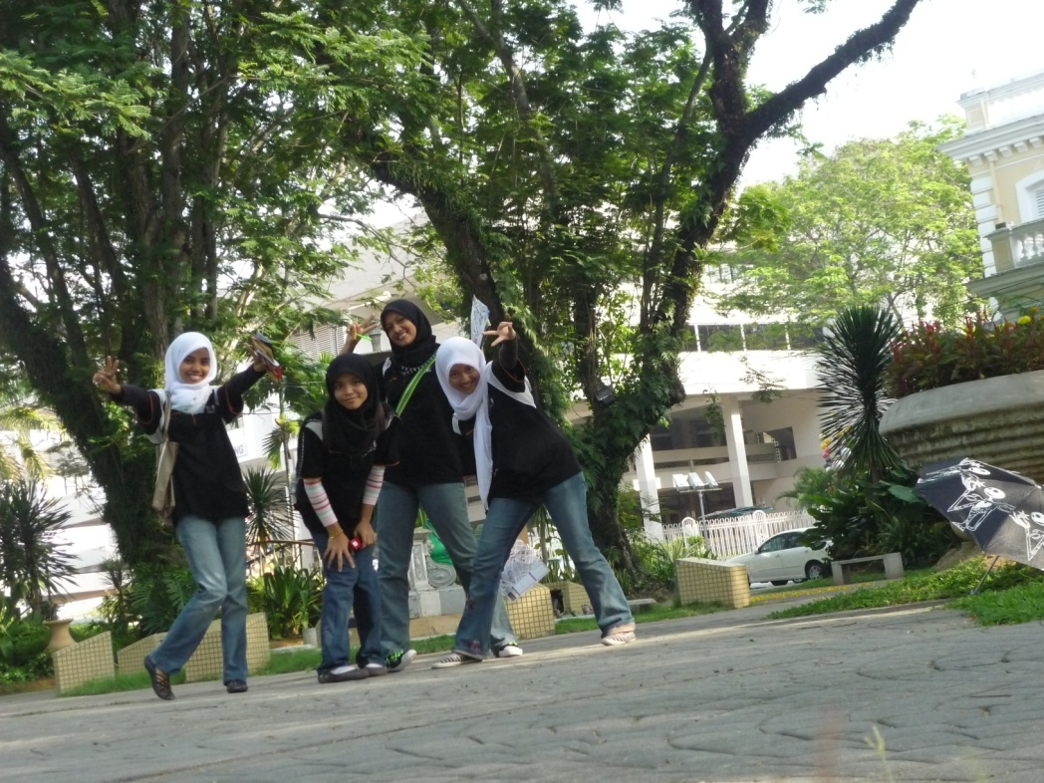
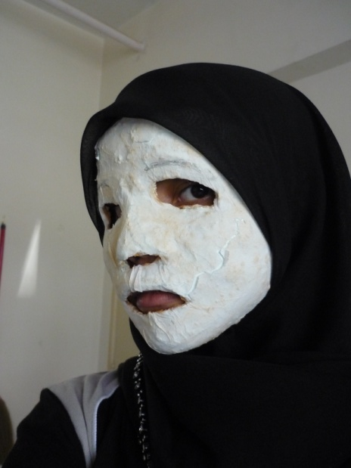
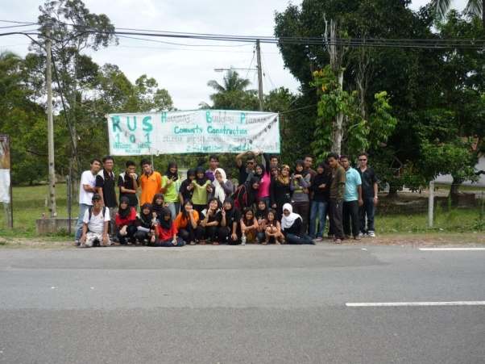
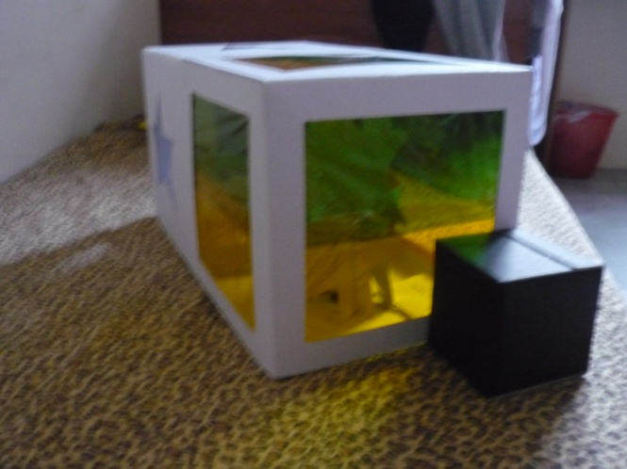
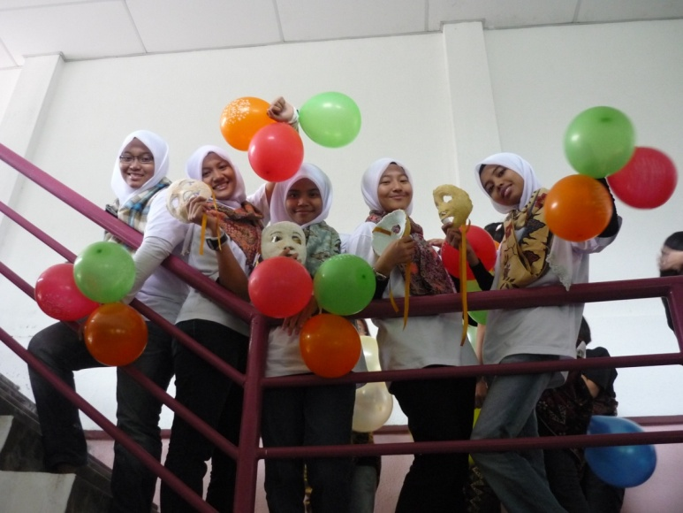
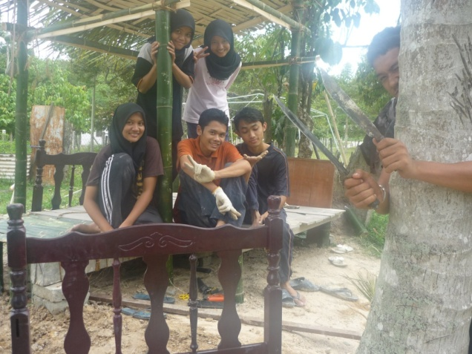
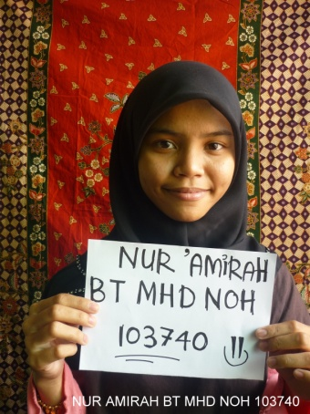
very unexpected tasks to do
Created and established new ideas
Generate new young generations creative and innovative thinking
Develop self-esteem and team works leadership
NUR’AMIRAH MHD NOH 103740

Slide 9
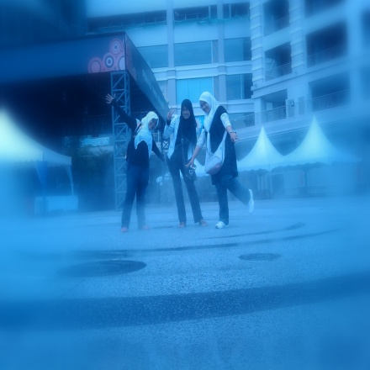





Studio 100 make us more thinkable and matured
Life no answer
lot of
question
LIFE IS NO
CTRL + Z
SITI NADIA BT KAMARUDIN 103772 ARCHITECTURE

Slide 10







When I come here, I have no idea about what I will learn. Just like I am nothing person.
But when I have been here about one semester with many challenging assignment to be done, it has taught me a lesson.
I have learn so many good and bad thing, It just like my first experience that I will use it to continue my life at USM.
After all of the assignment, I think I become somebody from nothing.
WAN ASMAA
103790

Slide 11









I got many experiences on doing something new in my life.
I had improve my skills and learnt on how to make something from nothing.
I learnt on how to respect others opinion and combined all the ideas to make the project success.
All this makes me more matured than before and realize mistake is the best teacher.
WAN SURIATI BINTI IDERIS 103795

Slide 12





‘’In a project run in my learning how to control each project and become more confident when confronted with people. project that are run like so challenging test of physical and mental test made me more creative ..’’
NOR HASLINDA MAT YAMAN 103732 INTERIOR DESIGN

Slide 13









KHOR SHUIN CHENG 103680 QUANTITY SURVEYING
Studio coursework sometimes make me confusing and become crazy.
Various technique skills can be learnt through project 1-8.
It’s good for me to learn something different and gain experience that cannot find in references books and hopefully can apply it in our future or daily life.

Slide 14






Every projects are not easy to do. Since I make the project I have to patient for make it complete. Sometime have no time to sleep. For HBP is not easier to study. I come to USM for study HBP and find a good job after graduate.
Also HBP they make me becoming to a professional. So I have to patient and renew my life better . And important thing is enjoy with it do not say boring and lazy. There is a professional…….
WALIB JEHSOHJEHLI 106444 ARCHITECTURE

Slide 15






ip
1.From first until the last project , I feel the studio give many experience as sad , happy ,challenging and stress. This is because ,it not only focus to study but it more focus to the project.
2.The studio make the student get ready for challenging in study at future.
3.I feel this experience can be used in life
MOHD ZAIDI BIN MOHAMAD ZAIN 103716 BUILDING TECHNOLOGY

Slide 16




To somebody for anybody
Project 1-8 is useful for me for the sake of my future. Start with “My Home” and “My Myself and I” that are to know who am I. Then “Natural Structure” and “Man-Made Structure” which are to understand what is the relation between nature and structure.”Mask” which is to know myself.
“Perspective,Projection Drawing and Black Box” are to nurture us.”Analysis of GT Spaces” were nurture me to work with nature.”Merdeka” and “An Urban Plan” to work with OTHERS. “Bamboo Box” is to feel the experience. And “Construction for Real” to be the somebody to anybody.
Mohd Ariff Bin Mohd Jafri 103708

Slide 17






















From the first project to the last project
SO !
NOTHING IS IMPOSSIBLE;
DON’T GIVE UP JUST DO IT
In these projects, some are difficult for me to do. But after a deep understanding and experience, I found that if i never start to try then I will never know what it’s all about.
LIM BEE KEE 103690 PLANNING

